Slide 1



Predicting Stress Using K-Means & Classification Models
NACME-Google Applied Machine Learning Intensive
Guysnove Lutumba¹, Allan Joseph², Ricardo Medina³, and Ella Kapanga⁴
¹Northern Kentucky University, ²Stevens Institute of Technology, ³The University of Texas at Austin, ⁴University of Kentucky
July 28th, 2022

Slide 2




Team
Guysnove Lutumba B.S. Data Science & Statistics | Allan Joseph B.S. Computer Science | Ricardo Medina B.S. Mechanical Engineering | Ella Kapanga B.S. Mechanical Engineering

Slide 3
Problem Statement
Interest
Develop a stress detection system that can monitor the stress level of patients using physiological parameters
Implement this model in the Assuage application to help patients know if they are under stress
Stress is big issue in our society, but many people do not have access to technologies that helps them detect and mitigate said stress

Slide 4





Tools Used

Slide 5
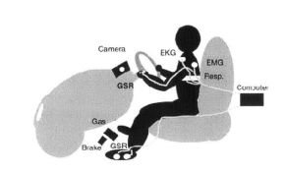
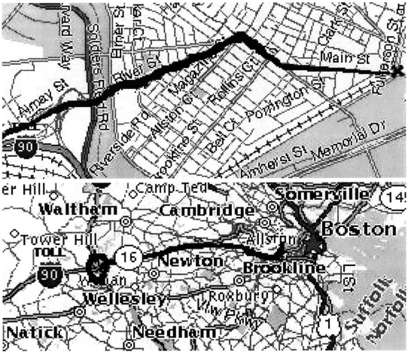
Data Description
Where data came from?
Stress Recognition in Automobile Drivers Database in the PhysioNet database
Name of Features:
Hand Galvanic Skin Response
Foot Galvanic Skin Response
Heart Rate
Respiratory Rate
Electromyogram (EMG)

Slide 6
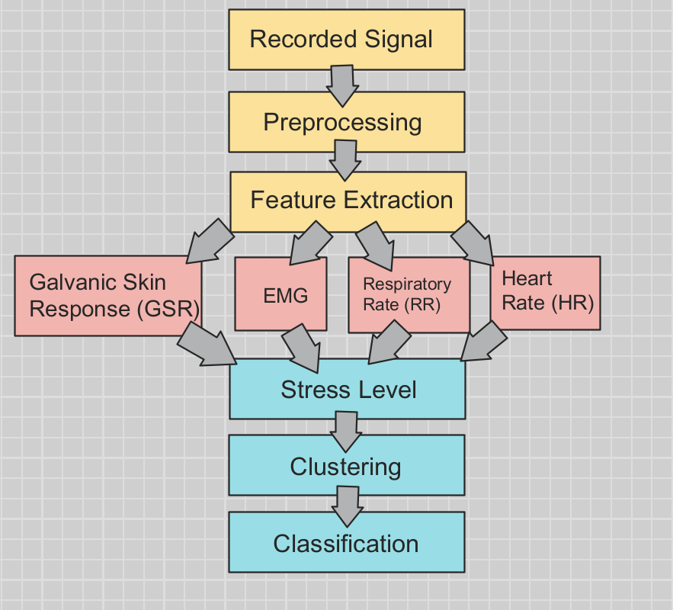
Methodology

Slide 7
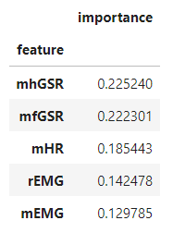
Feature Importance
The most important features are:
GSR
HR
EMG

Slide 8
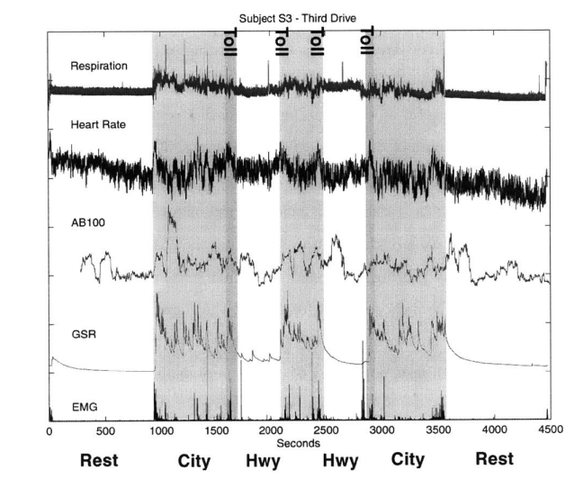
Stress Levels
Low Level - 1
Medium Level - 3
High Level - 5

Slide 9
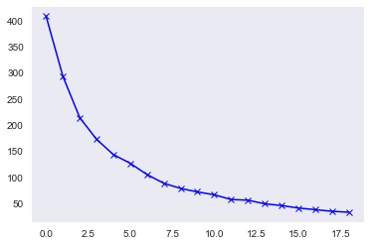
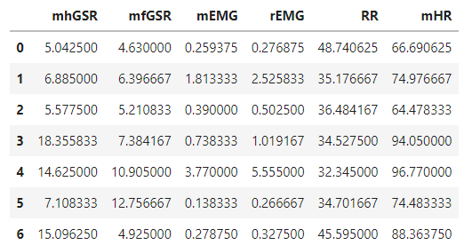
Clustering - Unsupervised Learning
K-means Clustering
Finding the Optimal Number of Clusters using the Elbow Method
(most optimal way to find the value of k)

Slide 10
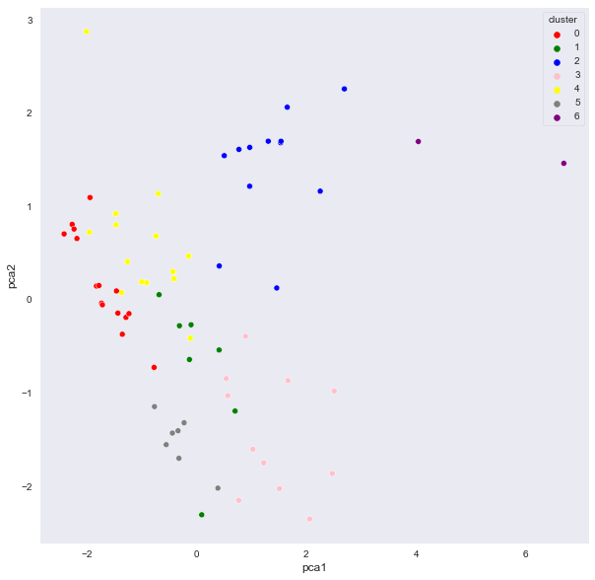
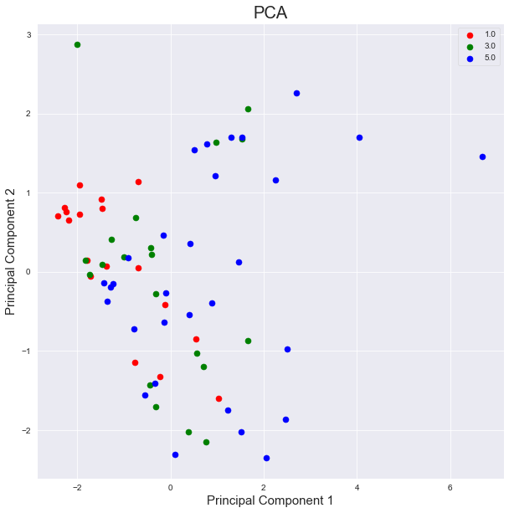
Cluster Visualization Using PCA
Cluster Visualization with Respect to Stress Level

Slide 11
Classification - Supervised Learning
Naive Bayes (NB)
Logistic Regression (LR)
Support Vector Machine (SVM)
K-Nearest Neighbors (KNN)
Artificial Neural Networks (ANN)
Random Forest (RF)

Slide 12
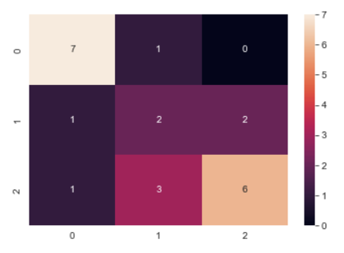
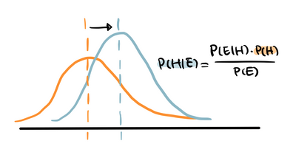
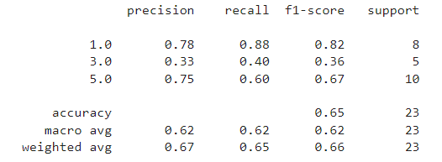
Naive Bayes with Multiclass Classification
Confusion Matrix
Visualization
Classification Report

Slide 13
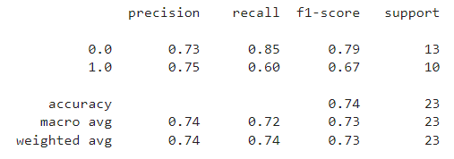
Naive Bayes with Binary Classification
Classification Report
Model | Accuracy
Multiclass | 0.67
Binary | 0.74
Hyper Tuning | 0.69

Slide 14
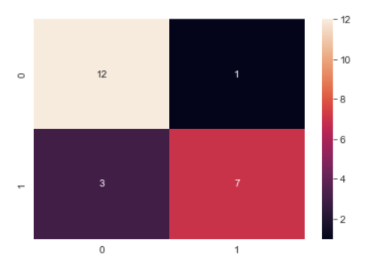
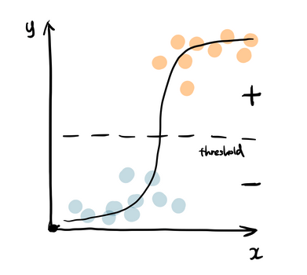
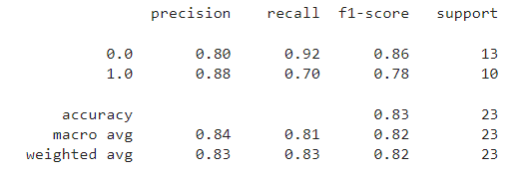
Logistic Regression
Confusion Matrix
Visualization
Classification Report

Slide 15
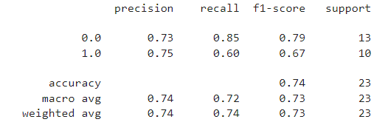
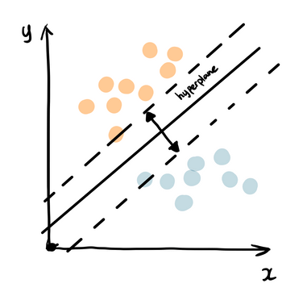
Support Vector Machine
Classification Report
Visualization

Slide 16
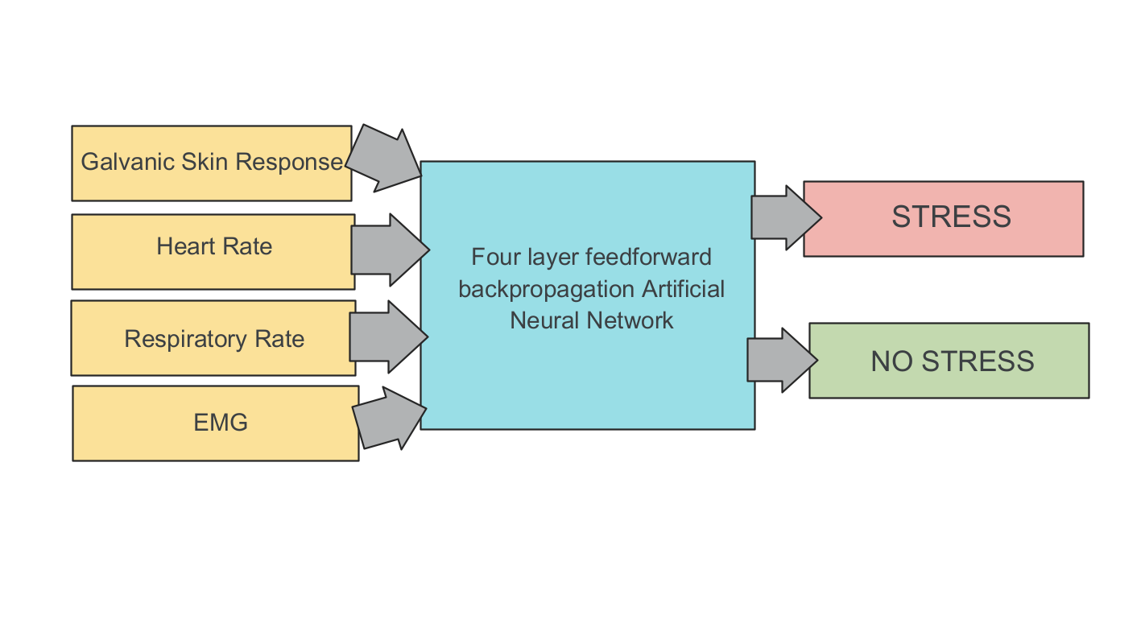
Artificial Neural Network

Slide 17
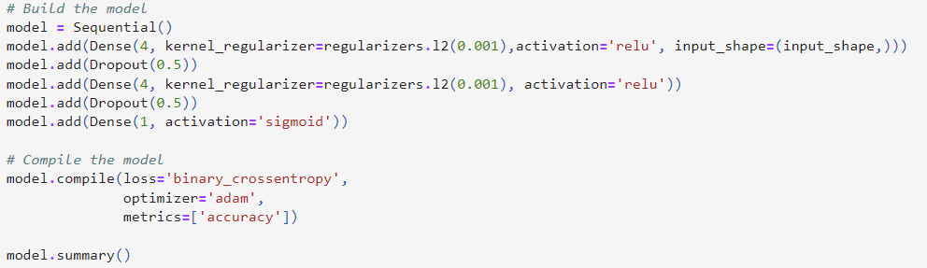
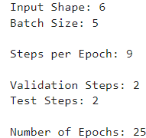
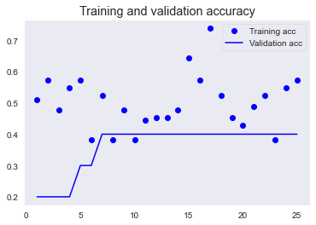
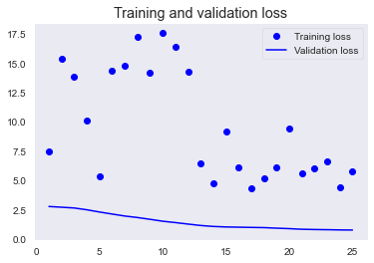
ANN Model with Tuned Hyperparameters
Training Accuracy: 0.57

Slide 18
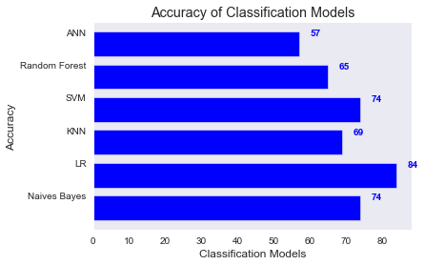
Model Comparison

Slide 19
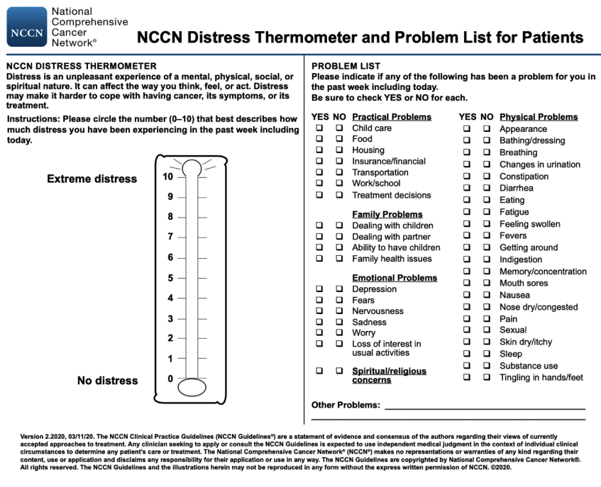
Future
Applications
Assuage App
Remote system monitoring in rural cancer patients
UK Markey Cancer Center
Implementation of new technology helps mitigate the digital divide
58% of rural settlers believe access to high speed internet is a problem their area
7 of 10 rural settlers have a smartphone
National Comprehensive Cancer Network’s Distress Thermometer
Notes:
DISTINCTION BETWEEN STRESS & DISTRESS!!!

Slide 20

Ethical Considerations
Privacy of Patient
False Positives & False Negatives
Data must be very well protected in order to ensure sensitive information does not get into the wrong hands
Some sort of encryption method must be in place to ensure greater safety
Important to NOT put patients in a state of panic by sounding a false alarm
False alarms could cause additional physical and mental health issues

Slide 21

Conclusion & Key Takeaways
Logistic regression is the best model to predict the stress level of patients
The features that contributed most to stress was the Galvanic Skin Response (GSR), Heart Rate (HR), and Electromyography (EMG)
Learned to apply K-Means models, as well as to implement Exploratory Data Analysis (EDA) on our data

Slide 22
Acknowledgements
We would like to thank the following people and organizations for this experience:
National Action Council for Minorities in Engineering
University of Kentucky
Google
Dr. Corey E. Baker
Michele Lezama
TA’s
Oscar Feliz
Jalen Collins

Slide 23
References
[1] “Assessing Cancer Patient Usability of Mobile Distress Screening App”. Alyssa Donawa, Christian Powell, Rong Wang, Ming-yuan Chih, Eliah Aronoff-Spencer, Corey E. Baker. 643-649.
[2]”Wearable and Automotive Systems for Affect Recognition from Physiology”. Jennifer A. Healey. Massachusetts Institute of Technology. May 2000. 93-126.
[3]”Classification of Stress Recognition using Artificial Neural Network”.Berina Alic, Digana Sejdinovic, Lejla Gurbeta, Almir Badnjevic. Mediterranean Conference on Embedded Computing. 297-300.
[4]”Correlation between Physiological Parameters of Automobile Drivers and Traffic Conditions”. Mandeep Singh, Abdullah Bin Queyam. IJEE. .6-12.
[5]”A Novel Method of Stress Detection using Physiological Measurements of Automobile Drivers”. Mandeep Singh, Abdullah Bin Queyam. IJEE. 13-20.
[6]”Evaluation of Statistical Metrics by Using Physiological Data to Identify the Stress Level of Drivers”. Cafer Avci, Ahmet Akbas, Yusuf Yuksel. International Conference on Environment, Chemistry and Biology, (2014). 124-128.
[7]”Evaluation of the physiological data indicating the dynamic stress level of drivers”. Ahmet Akbas/ 18 January, 2011. 430-439.https://academicjournals.org/SRE
[8]”Stress Classification Using K-means Clustering and Heart Rate Variability from Electrocardiogram”. International Journal of Biology and Biomedical Engineering (2022). 251-254.
[9]”Personalized Stress Monitoring using Wearable Sensors in Everyday Settings”. Ali Tazarv, Sina Labbaf, Stephanie M. Reich, Nikil Dutt, Amir M. Rahmani, Marco Levorato.

Slide 24
Questions?

